Slide 1
Easy Cabinet Maker

Slide 2
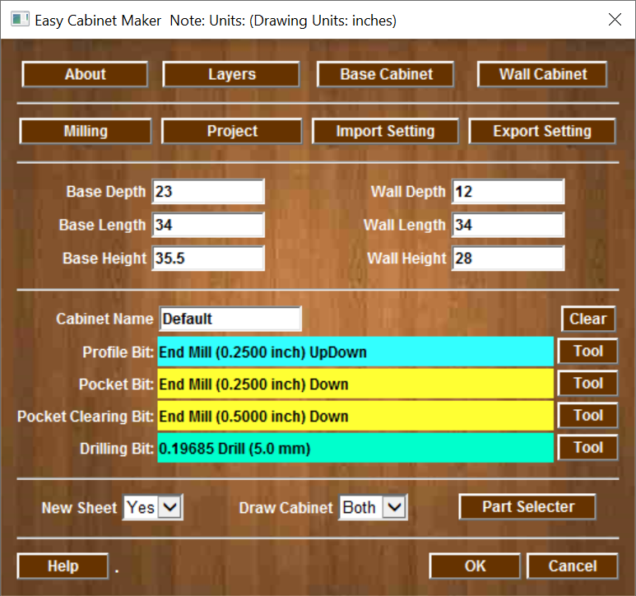
Main Screen
About Gadget
Default Settings
Import & Export Settings
Base Cabinet Size
Wall Cabinet size
Enter Cabinet Name (BOM)
Toolpaths will be added if you select tooling (tools are saved)
Select the cabinet parts will be drawn
Select the Cabinet to be drawn

Slide 3
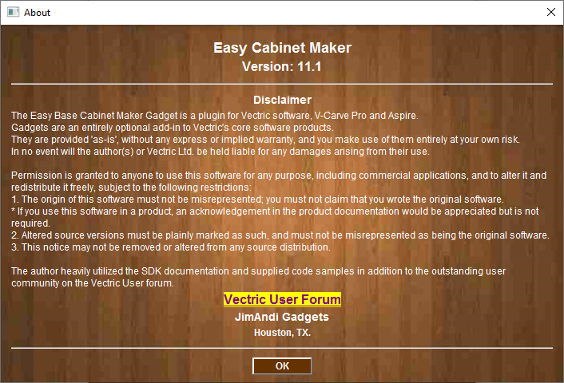
About Screen

Slide 4
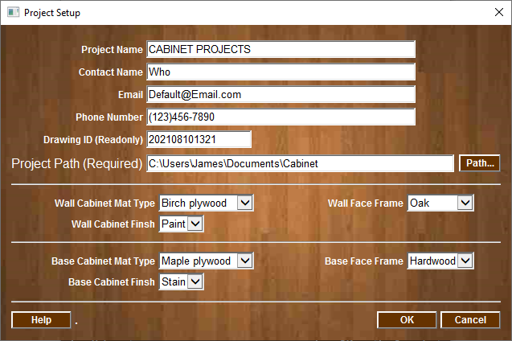
Project Setup
Enter the Project
And
Contact Information
Project Path is required. All logs and BOM will be written
Select material type and finsh

Slide 5
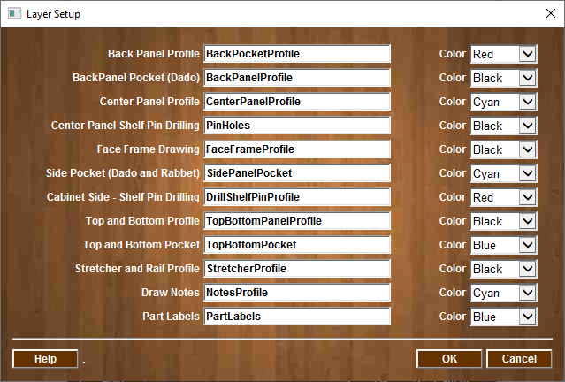
Layer Setup
Layer Colors
Layer Name for each milling operation

Slide 6
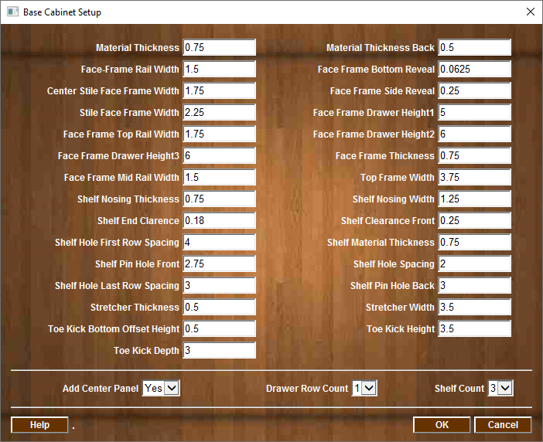
Base Cabinet Setup
Default values for Base Cabinet

Slide 7
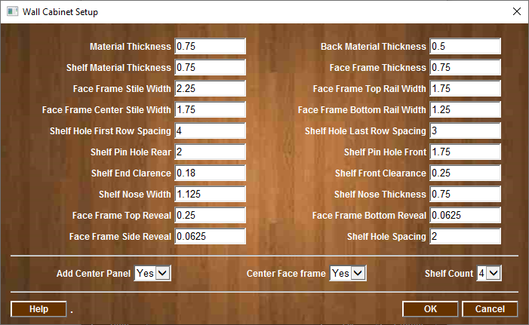
Wall Cabinet Setup
Default values for Wall (Upper) Cabinet

Slide 8
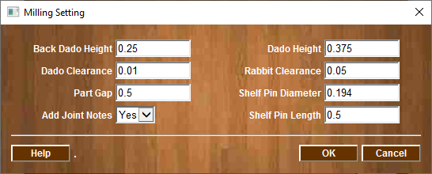
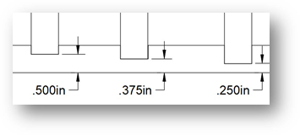
Milling Settings Menu
Default values for Milling
Note: Back Dado Height and Dado Height are measurements from the material back to the bottom of the Dado. Sheet goods very in thickness, a 3/4” plywood is never 3/4” it is usually 23/32” thick or less. This will ensure the overall dimensions of the cabinet will be accurate regardless of thickness of the material being used.
Dado Height Value
Material Back/Bottom

Slide 9
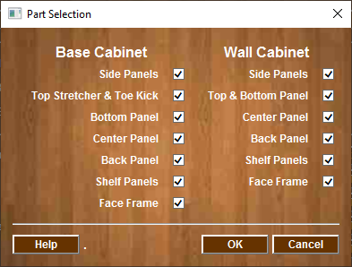
Part Selection Menu
Select which parts to ben drawn on current sheet

Slide 10
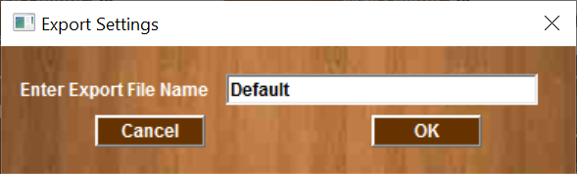
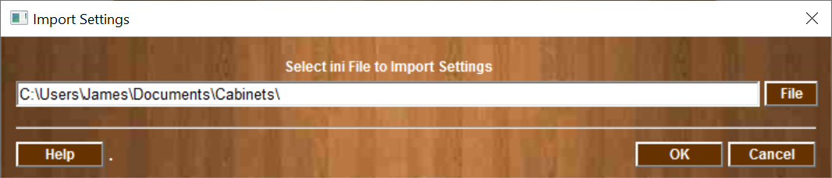
Import & Export Settings Menus
The Import & Export function can allow the user to save all of the cabinet settings to a file and be recalled as needed.
The system will automatically append “-YYYYMMDDHHMM” to the file name to ensure the export name is unique.
Enter File name for Cabinet Export Settings
Select File Cabinet Settings Import

Slide 11
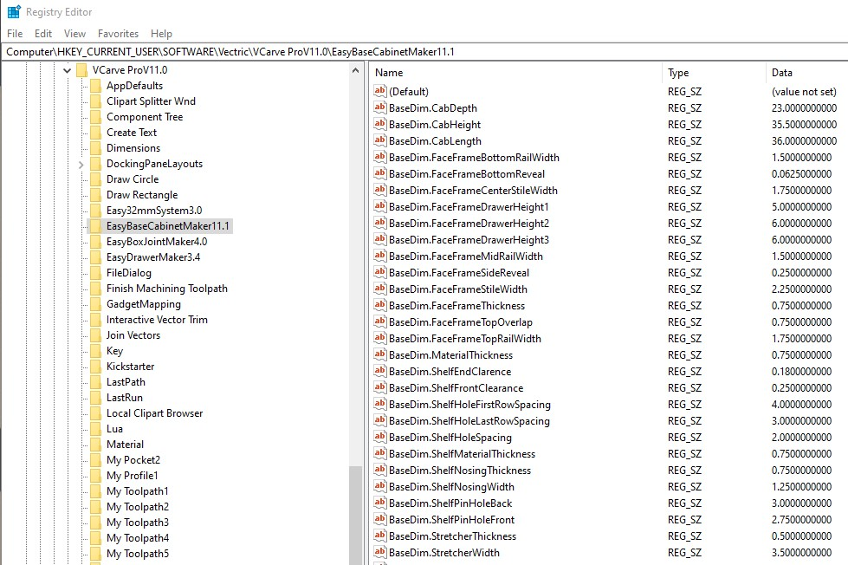
Registry Data
All data is stored in the system registry and can be accessed using the Microsoft Regedit tool

Slide 12
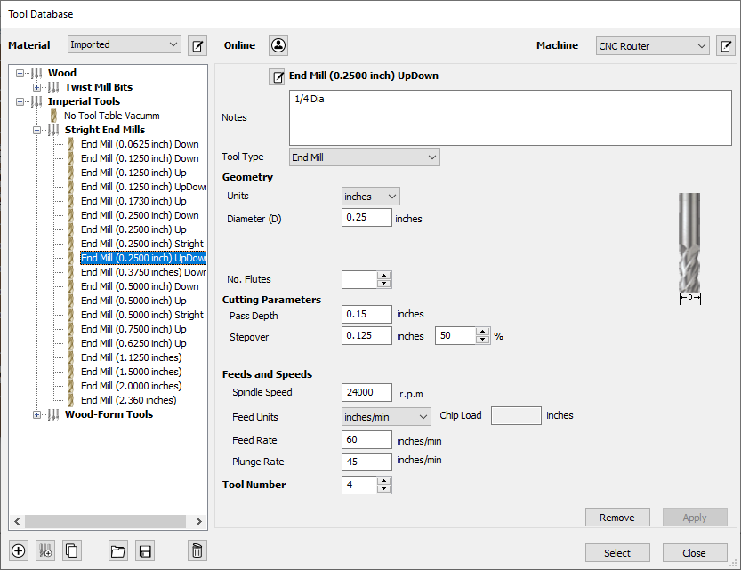
Tool Selection for Part Profile

Slide 13
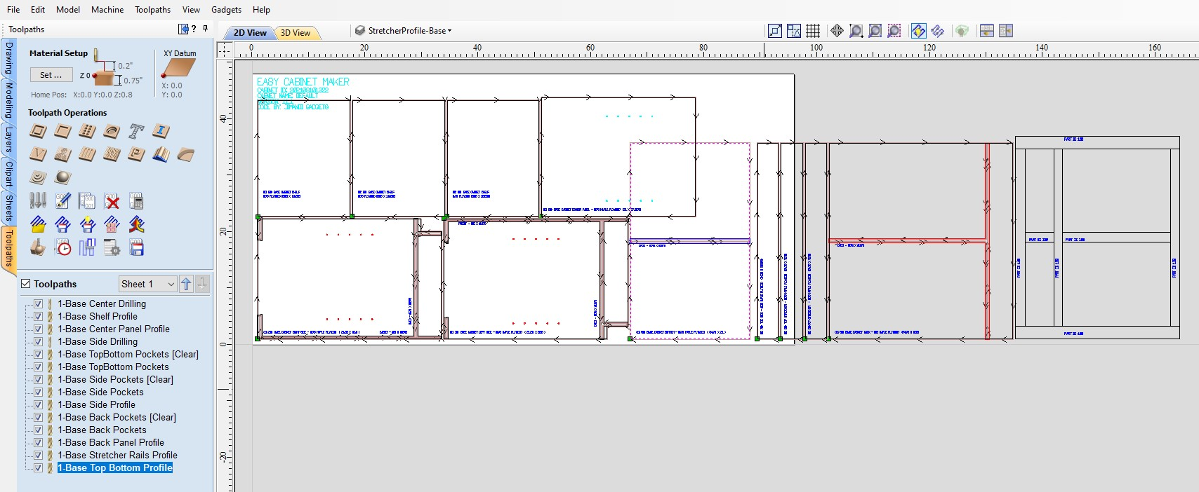
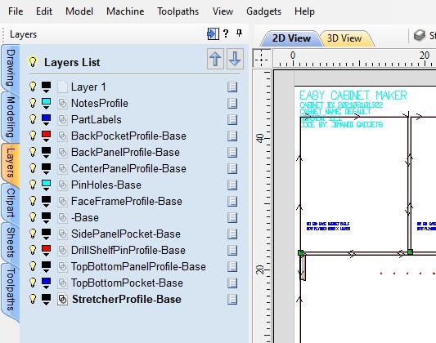
Layers and Toolpaths

Slide 14
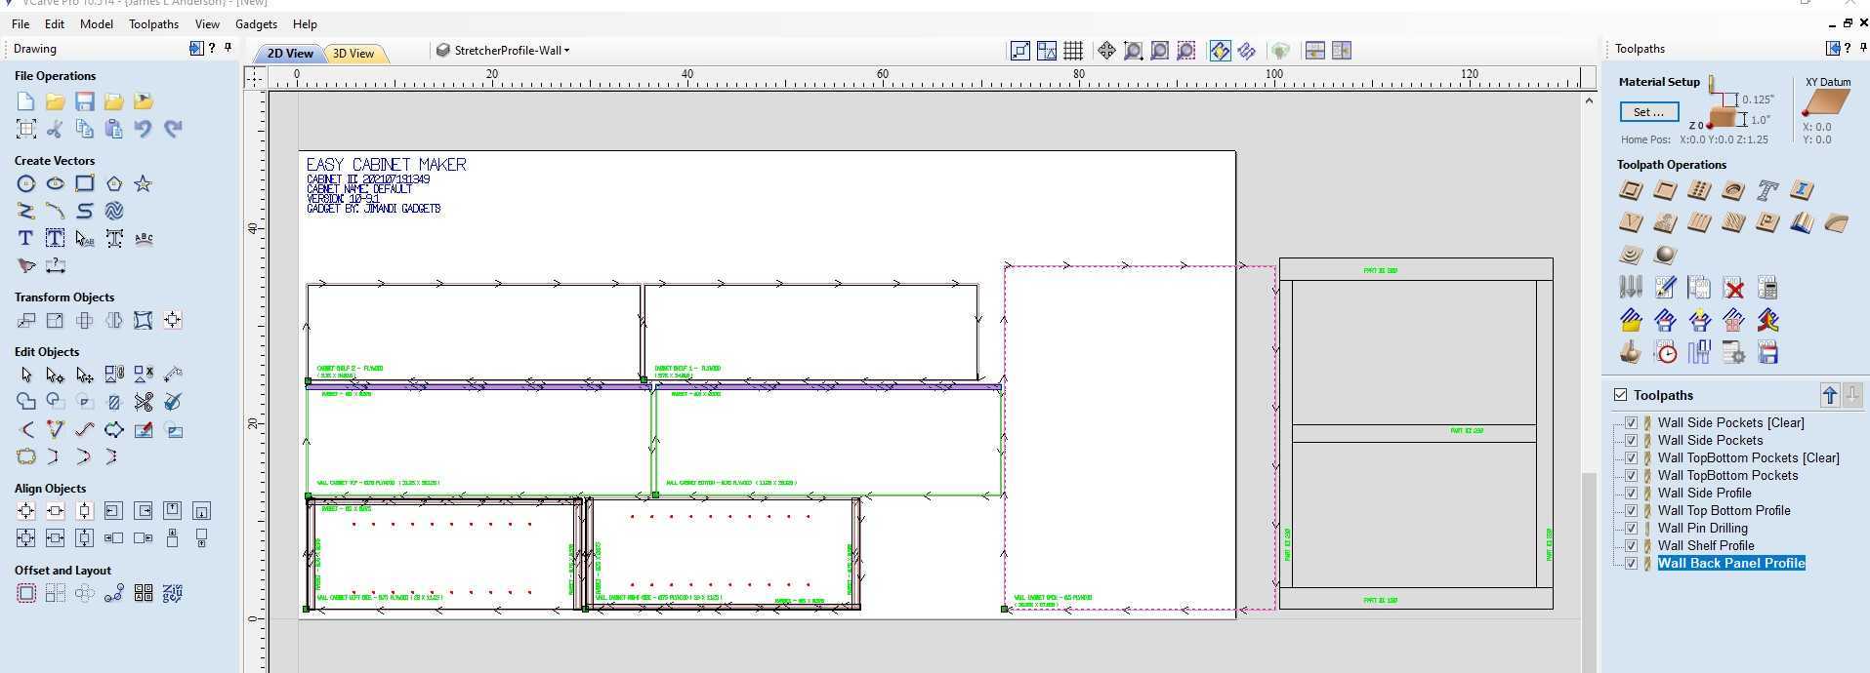
Wall Cabinet Layout

Slide 15
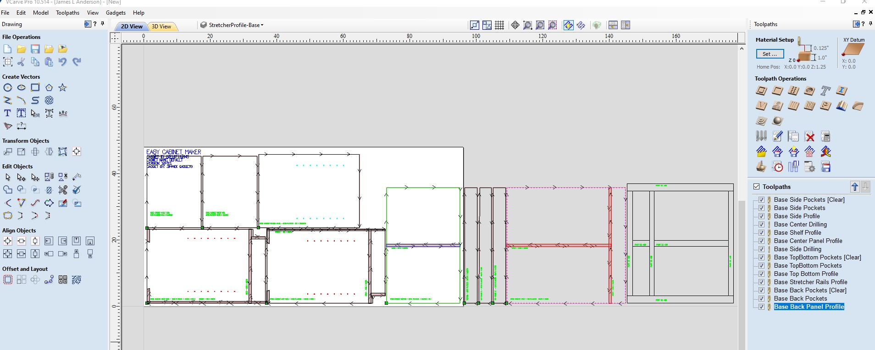
Base Cabinet Layout

Slide 16
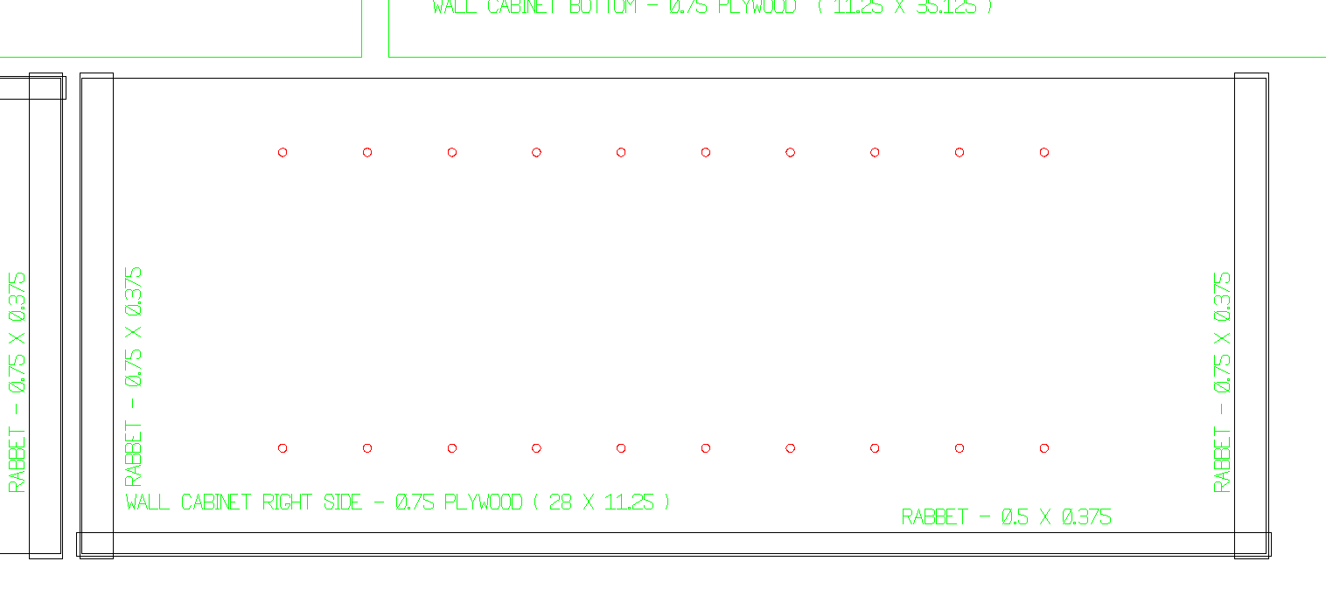
Part and Milling Notation
Each Part is labeled with
Where it is used, Thickness, Length, and Width
Each Milling operation is labeled with Type, Width and Height

Slide 17
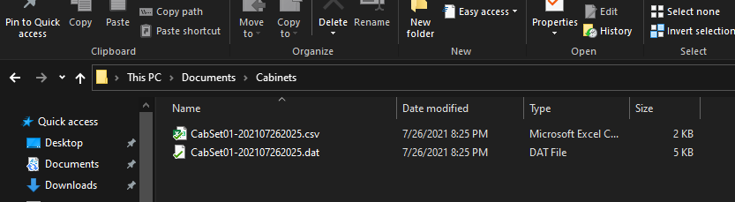
Bill of Material Files

Slide 18
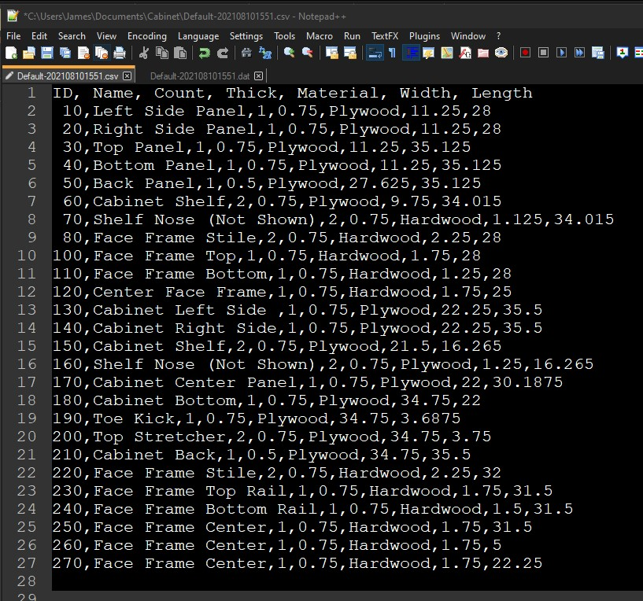
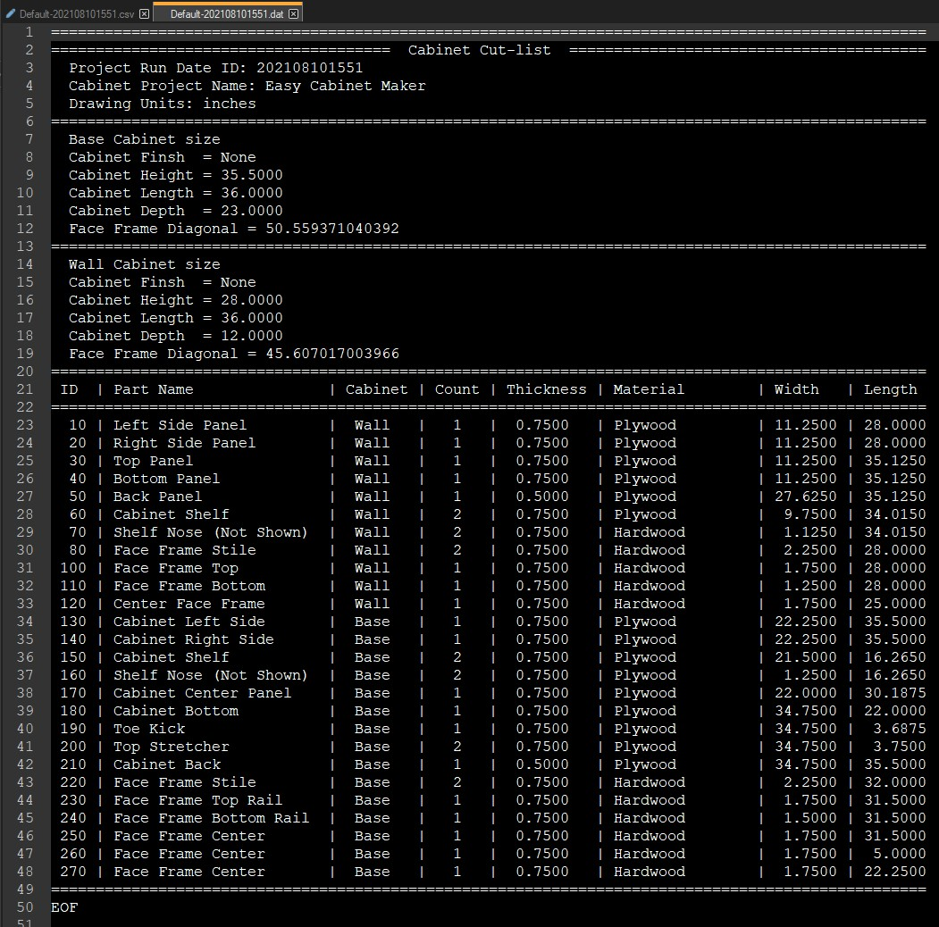
Edit CSV file in Excel or Text editor

